Slide 1
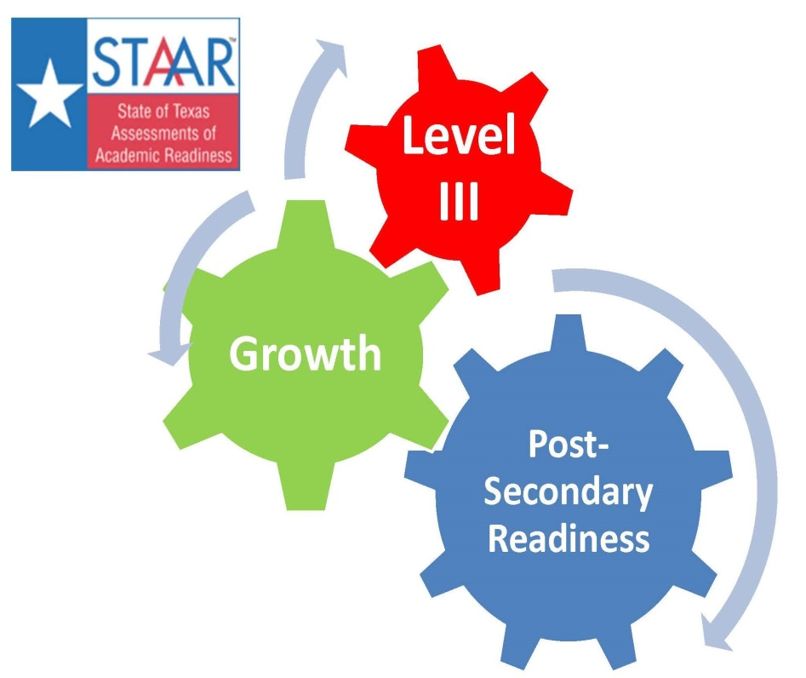
Accountability 2013 and Beyond!
Tori Mitchell
tmitchell@ec17.net
@esc17ace
Shauna Lane
slane@esc17.net
@esc17counselors
Ty Duncan
tduncan@esc17.net
@instructionalle

Slide 2
Register for October 8th
http://escite2.esc17.net/default.aspx?name=wmsworkshop&w=13883
Breakout Sessions Including:
NCLB Waiver Update
Accountability 2014
Branding Your School for HB5
Instructional Coaching Follow-up
HB5 Updates
Along with program updates for all areas of Leadership!

Slide 3
Back to School Workshop with Jim Walsh on September 4th
https://legaldigestevents.com/event-registration/?ee=17
The 8th Annual Back to School Program will feature a comprehensive review of legal developments that will impact the day-to-day operations of public schools from the classroom to the principal’s office to the board room. There are new laws at both the state and federal level as well as newly promulgated regulations and court cases. As usual, the presentation will be lively, upbeat, and interactive, allowing plenty of time for Q and A. You will come away with specific to-do lists and tools to help you avoid legal problems in the upcoming year.

Slide 4
https://www.facebook.com/pages/Region-17-Instructional-Leaders/204792002878635

Slide 5
The Backchannel Communication
http://todaysmeet.com/ESCACC
Handling our backchannel communication today is:
Tori Mitchell
tmitchell@ec17.net
@esc17ace
Shauna Lane
slane@esc17.net
@esc17counselors

Slide 6
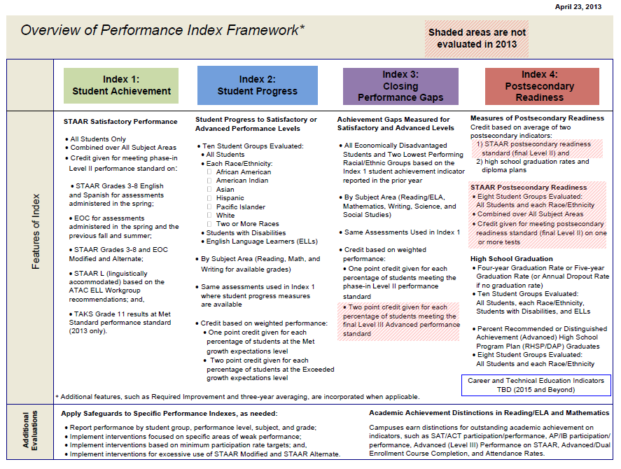
Performance Index Framework

Slide 8
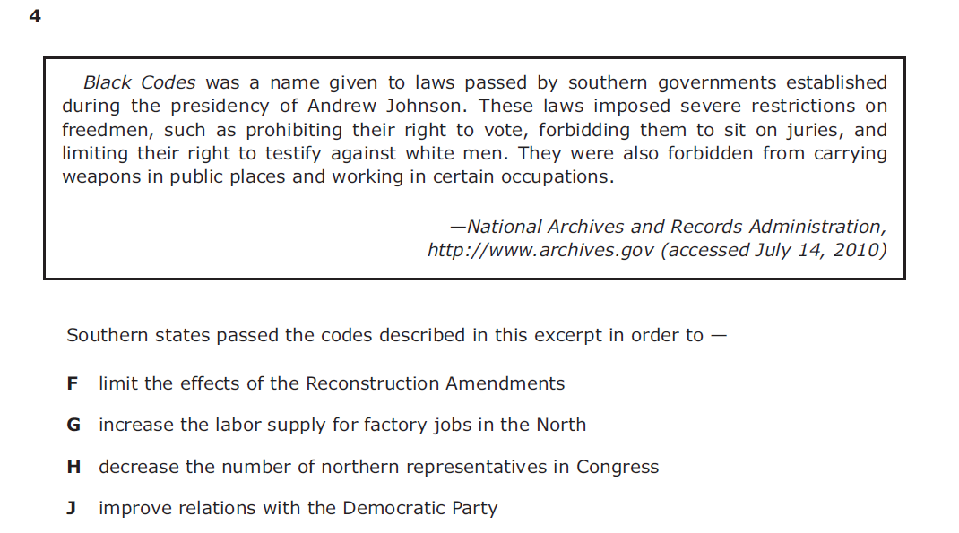

Slide 9
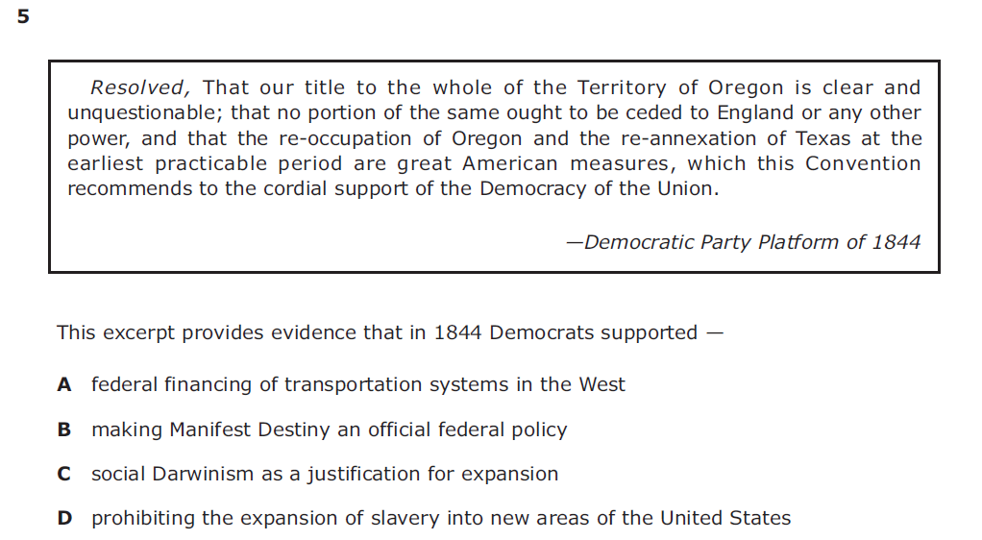

Slide 13
Performance Index Criteria 2013 Rating Labels
2013 Rating Labels:
Met Standard – met performance index targets on all indexes for which they have performance data in 2013.
High Schools – All 4 index targets
Elementary and Middle Schools – All 3 index targets where they have data.
Improvement Required: Did not meet one or more performance index targets.

Slide 14
2013 Ratings Criteria
To receive a Met Standard Rating all campuses and districts must meet the following accountability targets:
Each of the four indexes will have a score of 0 to 100 to represent the campus or district performance:
Targets | Districts and Campuses
Index 1: Student Achievement | 50
Index 2: Student Progress | 5th percentile*
Index 3: Closing Performance Gaps | 55
Index 4: Postsecondary Readiness | 75
*Target will be set at about the fifth percentile of campus performance and will be applied to both campuses and districts.
Notes:
Page 12 of the Accountability Manual

Slide 15
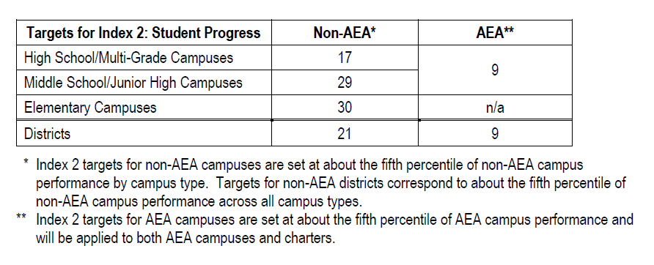
Index 2 Targets for 2013

Slide 16
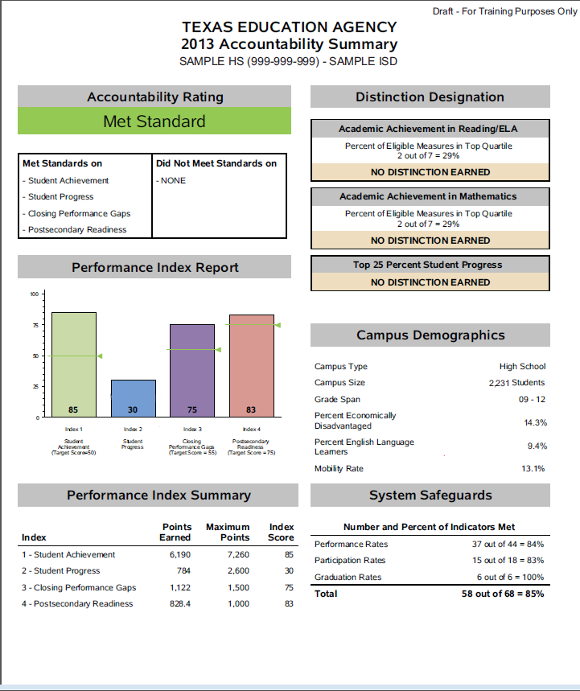
What does this report tell you about a campus?

Slide 17
Index 1: Student Achievement
Index 1 Student Achievement provides an overview of student performance based on satisfactory student achievement across all subjects for all students.
Subjects: Combined over Reading, Mathematics, Writing, Science, and Social Studies.
Student Groups: All Students only
Performance Standards: Phase-in 1 Level II (Satisfactory)

Slide 18
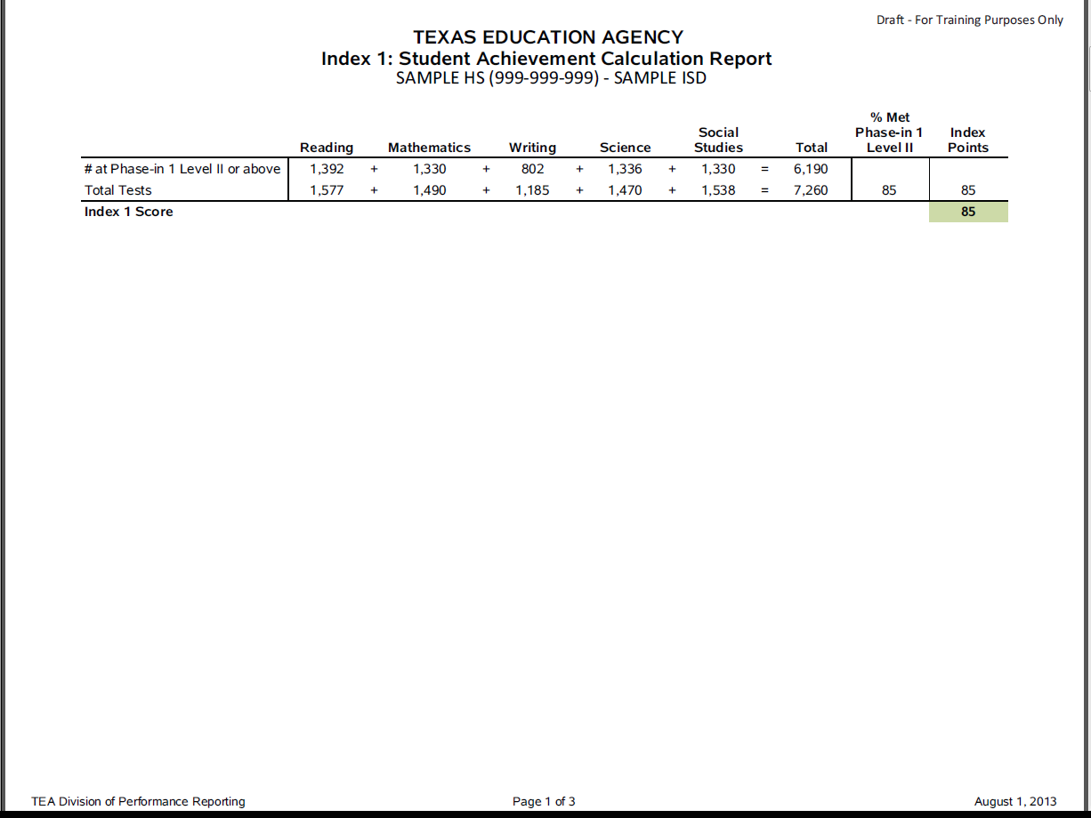
What does the calculation report indicate about a campus?
What would an Index score of 45 indicate about the campus?

Slide 19
Region 17 District Index 1 Scores

Slide 20
Index 2: Student Progress
Index 2: Student Progress focuses on actual student growth independent of overall achievement levels for each race/ethnicity student group, students with disabilities, and English language learners.
By Subject Area: Reading, Mathematics, and Writing for available grades.
Credit based on weighted performance:
One point credit given for each percentage of students at the Met growth expectations level.
Two point credit given for each percentage of students at the Exceeded growth expectations level.

Slide 21
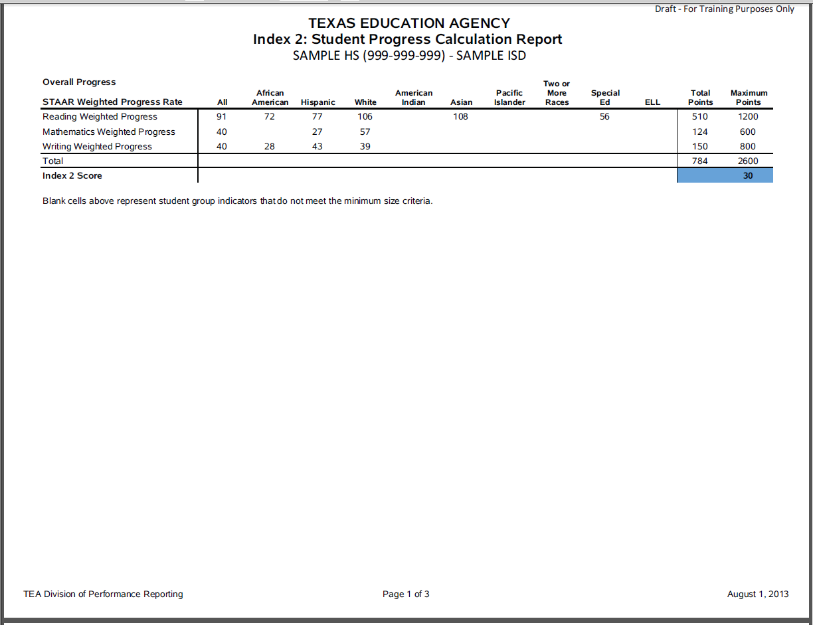
Set a side for a minute

Slide 22
Methodology
Met- one point for each percent of student at the Met growth expectation level
Exceeded- two points for each percent of students at the Exceeded growth expectations level

Slide 23
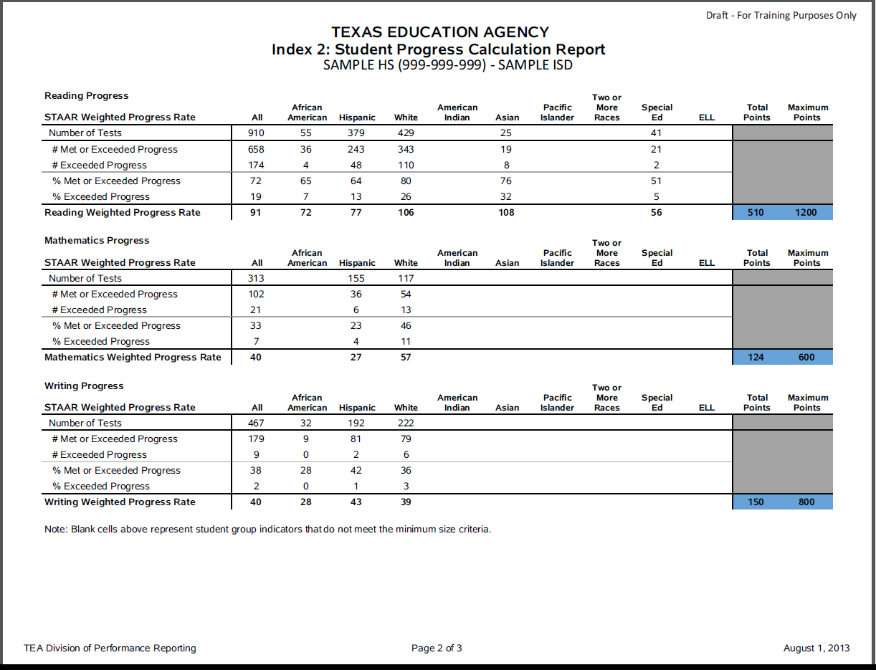

Slide 25
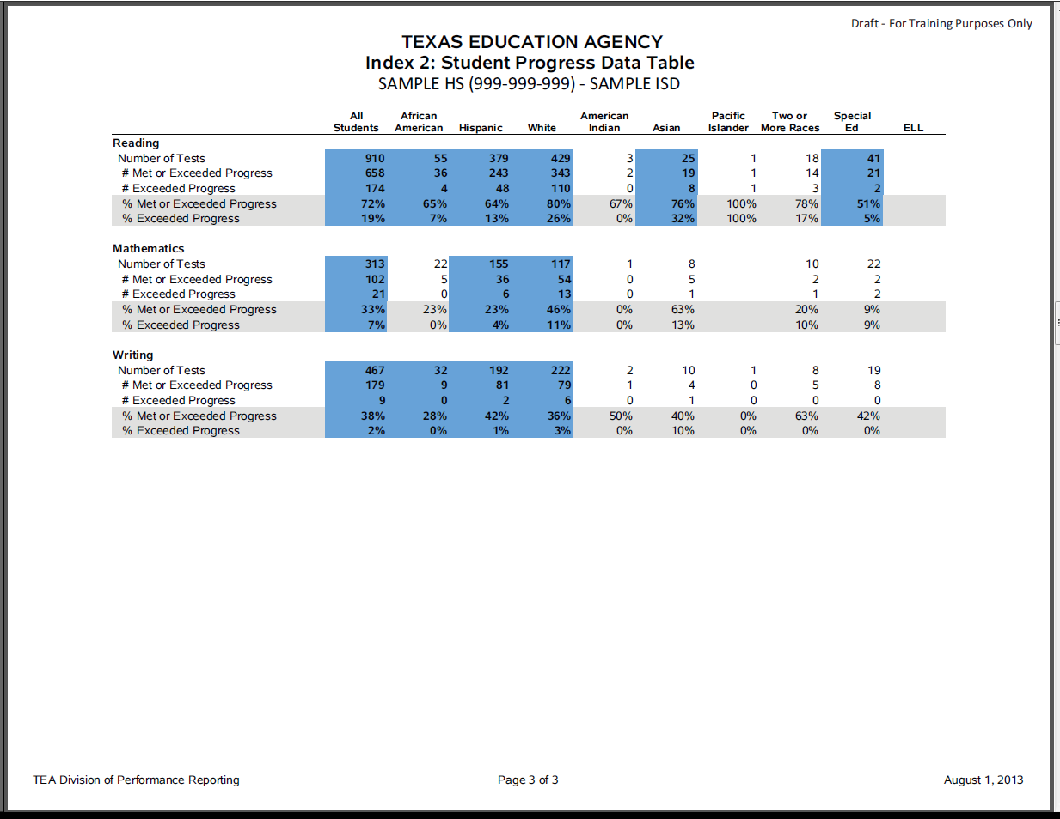

Slide 26
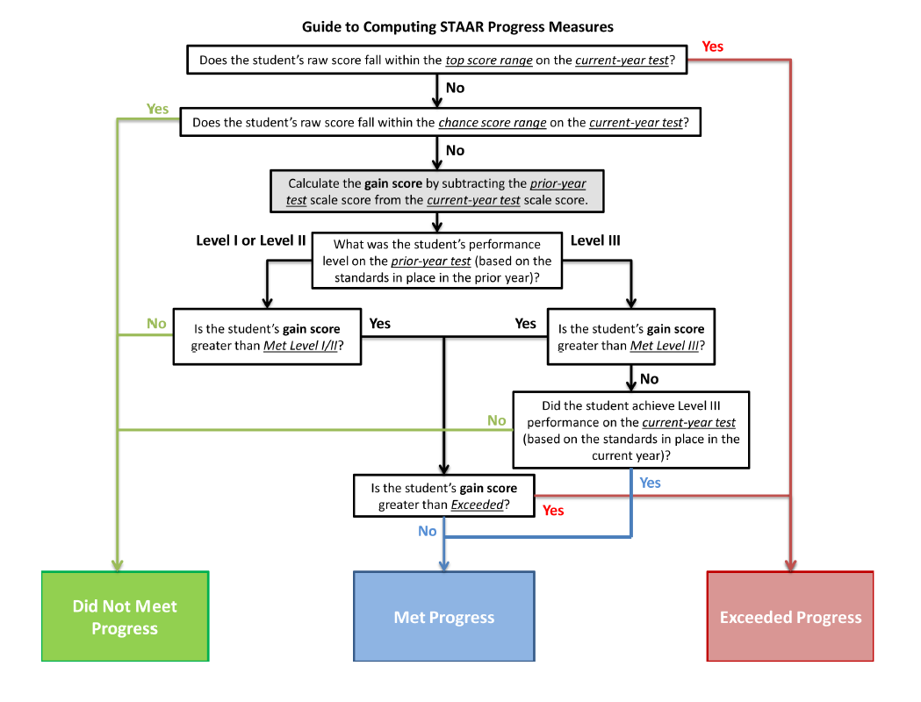
Index 2: Student Progress

Slide 27
Region 17 Index 2 Scores

Slide 28
Index 3: Closing Performance Gaps
Index 3: Closing Performance Gaps emphasizes advanced academic achievement of economically disadvantaged students and the two lowest performing race/ethnicity student groups.
Credit based on weighted performance:
Phase-in Level II satisfactory performance (2013 and beyond) One point for each percent of students at the phase-in Level II satisfactory performance standard.
Level III advanced performance (2014 and beyond) Two points for each percent of students at the Level III advanced performance standard.
The STAAR weighted performance rate calculation must be modified for 2013 because STAAR Level III advanced performance cannot be included in the indicator until 2014.

Slide 29
Index 3: Closing Performance Gaps
By Subject Area: Reading, Mathematics, Writing, Science, and Social Studies.
Student Groups
Socioeconomic: Economically Disadvantaged
Lowest Performing Race/Ethnicity: The two lowest performing race/ ethnicity student groups on the campus or district (based on prior-year assessment results).

Slide 30
Economically Disadvantaged group always evaluated

Slide 31
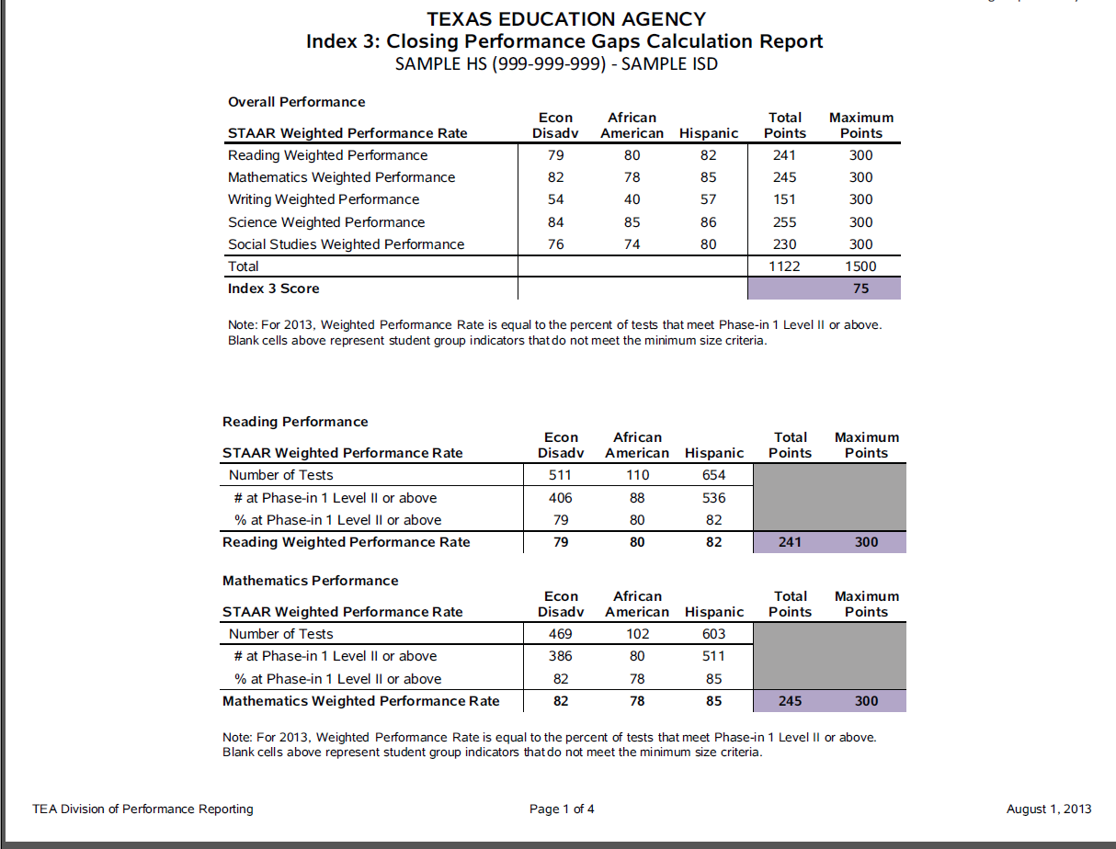
Set a Side

Slide 32
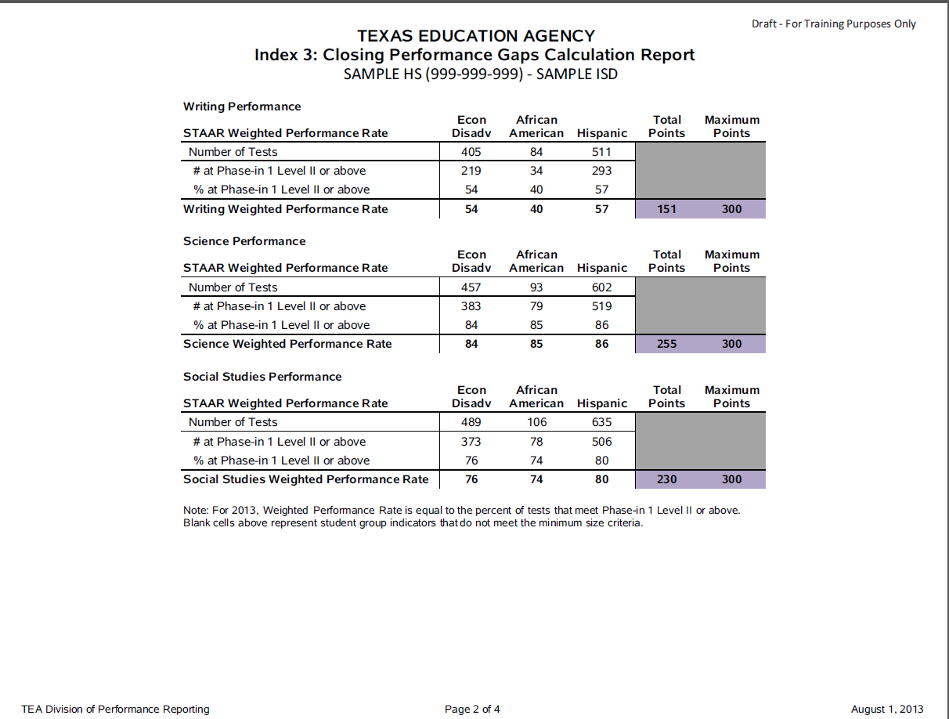
Set a Side

Slide 33
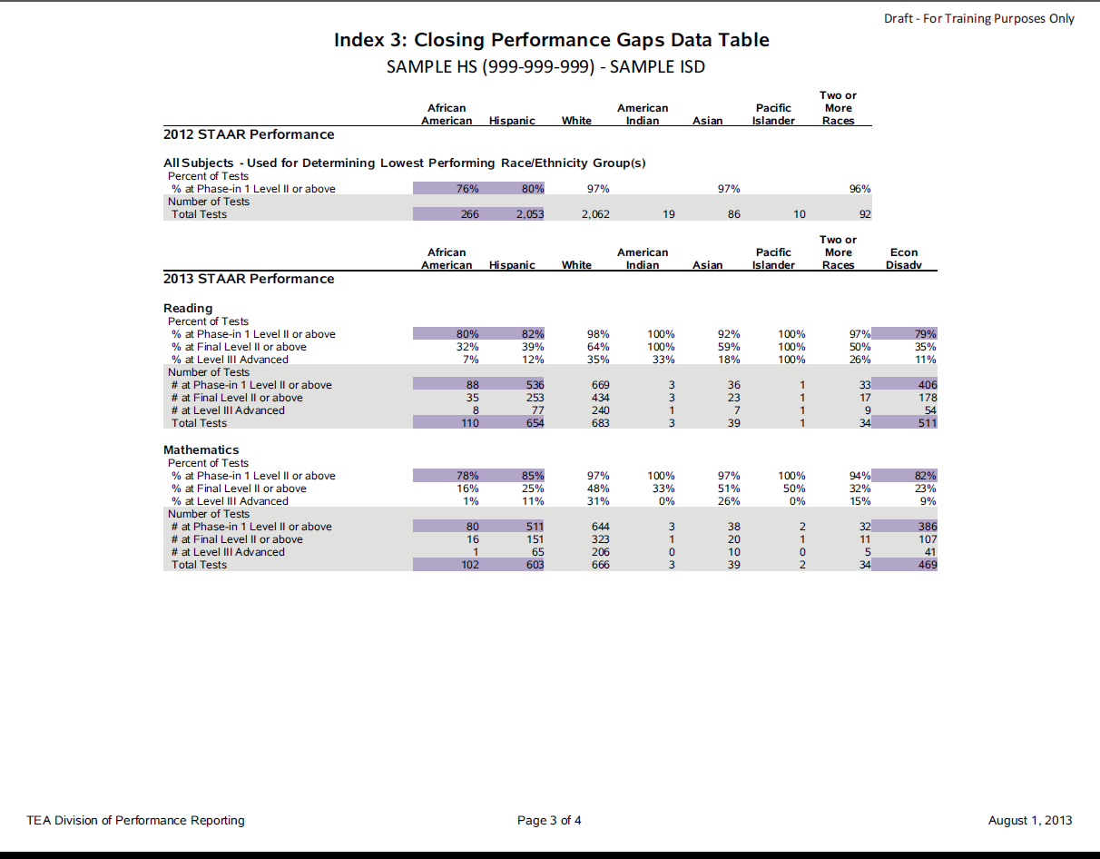

Slide 34
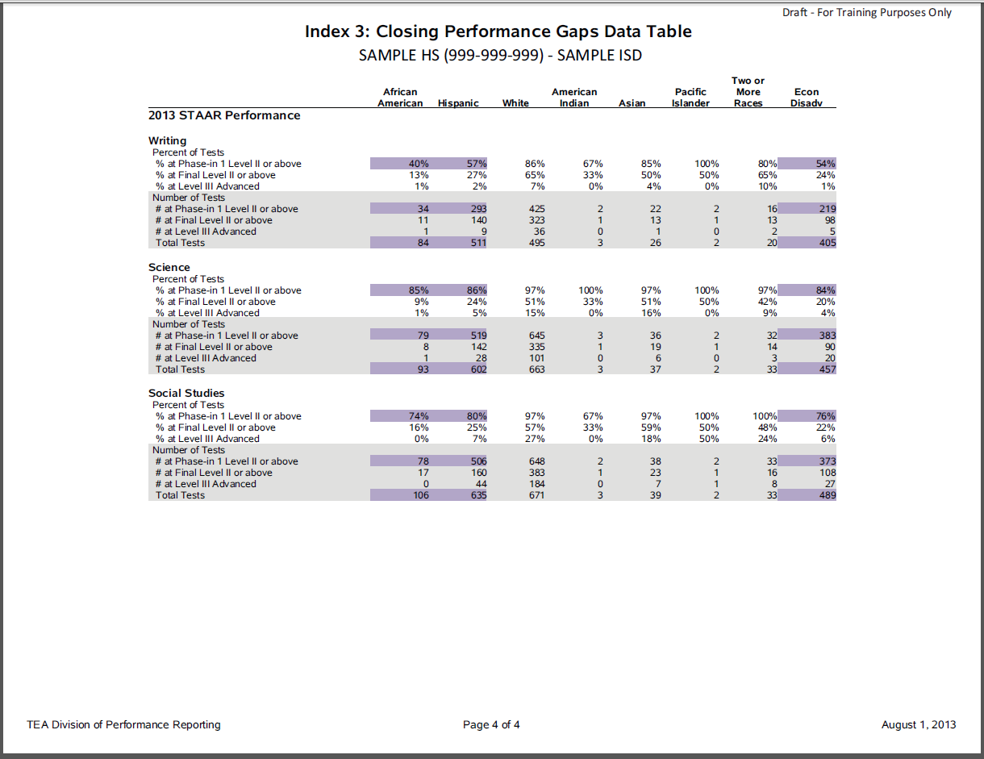

Slide 37
Region 17 Index 3 District Scores

Slide 38
How will each subject tested affect the overall Index 3 score?
What recommendations would you make to this campus based on the sample reports?

Slide 40
Index 4: Postsecondary Readiness
Index 4: Postsecondary Readiness emphasizes the importance for students to receive a high school diploma that provides them with the foundation necessary for success in college, the workforce, job training programs, or the military; and the role of elementary and middle schools in preparing students for high school.
Graduation Score: Combined performance across the graduation and dropout rates for
Grade 9-12 Four-Year Graduation Rate for All Students and all student groups OR
Grade 9-12 Five-Year Graduation Rate for All Students and all student groups, whichever contributes the higher number of points to the index.
RHSP/AHSP Graduates for All Students and race/ethnicity student groups
STAAR Score: STAAR Percent Met Final Level II on One or More Tests for All Students and race/ethnicity student groups (2014 and beyond)

Slide 41
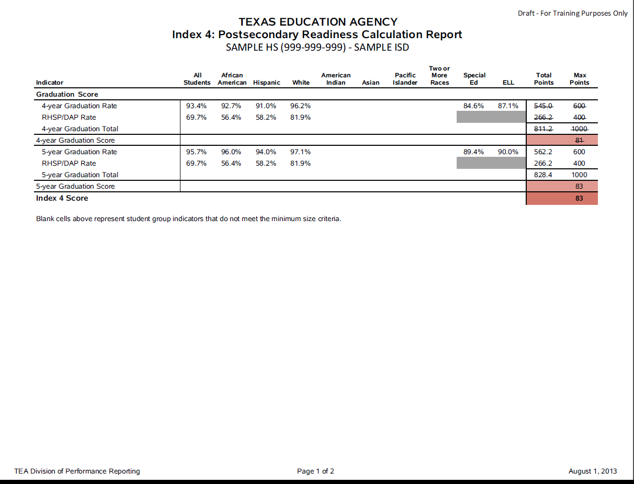

Slide 42
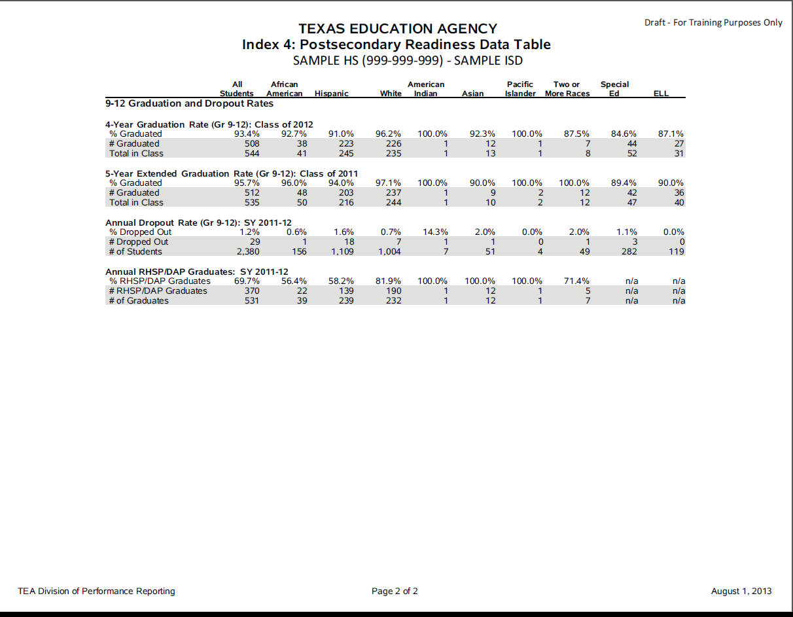

Slide 43
Region 17 Index 4 District Averages
Regional Ave. 91

Slide 44
System Safeguards
With the PI framework, poor performance in one subject or one student group does not result in an Improvement Required Rating.
System safeguards are added to ensure that poor performance in one area or one student group is not masked in the performance index.
Texas Accountability Intervention System (TAIS)

Slide 45
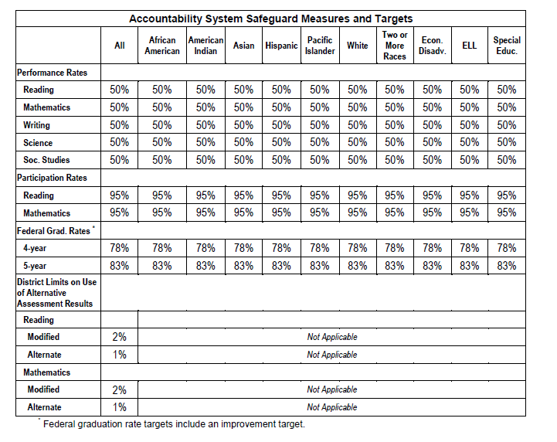
System Safeguards

Slide 46
Purpose
Ensure system disaggregates performance by student group, performance level, subject area, and grade
Target for disaggregated results meet and exceed federal requirements
Performance Target
Participation Rate
Graduation rate targets and improvement
Limit on Alternative Assessments

Slide 47
Impact
Results are reported for any cell that meets minimum size criteria.
Failure to meet the safeguard target for any reported cell must be addressed
Performance on the safeguard indicators are incorporated into the Texas Accountability Intervention System (TAIS)

Slide 48
There is no “death by single cell” but there is “paperwork by single cell.”

Slide 49
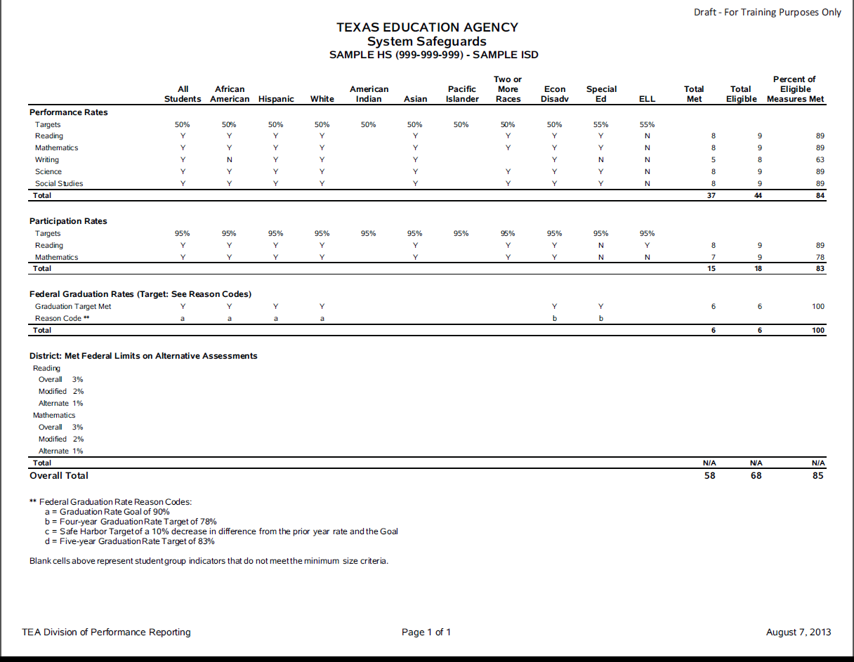

Slide 52
Top 25% Student Progress Distinction
Top 25% Student Progress Distinction
Campuses in the top 25% (top quartile) of their campus comparison group on Index 2: Student Progress score are eligible for a distinction designation for student progress.
Campuses only [statutory requirement]
Eligibility criteria – Met Standard rating [statutory requirement]
Campuses in the top 25% (top quartile) in student progress [statutory requirement]
Campus comparison groups from Academic Achievement Distinction Designations

Slide 53
Academic Achievement Distinction Designations
Distinction Designation Indicators
Indicators evaluated include performance at the STAAR Level III (Advanced) standard for selected grades and subject areas in elementary and middle schools, and indicators including SAT/ACT and AP/IB participation and performance for high schools.
For details, refer to Chapter 6 of the 2013 Accountability Manual at http://ritter.tea.state.tx.us/perfreport/account/2013/manual/ch06.pdf

Slide 54
Academic Achievement Distinction Designations
Distinction Designation Framework Steps
The framework for distinction designations uses four steps to determine a campus distinction.
Step 1: Campus Comparison Group and Profile A campus comparison group of 40 campuses is selected for each campus. Campus performance on each distinction indicator, by subject, is reported. Comparison groups provided to districts on June 24, 2013.
Step 2: Top 25% For each indicator, compare the performance of the target campus to the performance of the campuses in the comparison group. For example, Campus A is in the top 25% of campuses among a 40 campus comparison group on a particular distinction indicator.

Slide 55
Academic Achievement Distinction Designations
Distinction Designation Framework Steps (continued)
Step 3: Campus Outcome by Subject Generate a single outcome by subject for each campus based on the percent of measures in the top quartile. For example, Campus A achieved the top 25% in three of the six (50%) mathematics distinction indicators that were evaluated for the campus.
Step 4: Apply State Target The statewide evaluation of campus outcomes identify the top campus distinction designations by subject. For example, elementary campuses that outperformed their peers on 50% or more of the mathematics distinction indicators evaluated are qualified to receive an academic distinction in mathematics.

Slide 56
Academic Achievement Distinction Designations
Distinction Designation Targets
Campuses in the top 25% (top quartile) of their campus comparison group in Step 2 are eligible for a distinction designation for that subject area.
Statewide Targets are designated by type of campus:
Elementary and middle school campuses in the top quartile on at least 50% of their eligible measures are qualified to receive a distinction designation for that subject area.
High schools and K-12 Campuses in the top quartile on at least 33% of their eligible measures are qualified to receive a distinction designation for that subject area.

Slide 57
2014 Accountability and Testing
Looking at what is ahead….

Slide 58
AYP – The USDE Waiver
TEA has requested that the USDE waive specific provisions of the Elementary and Secondary Education Act (ESEA).
The waiver requests that the current Adequate Yearly Progress (AYP) calculations and performance targets be replaced with the state’s accountability rating system.
If the waiver is not approved, the commissioner will have to consider other options that will meet federal requirements for 2013.
It is unknown when the AYP Accountability Ratings for 2013 will be announced.
100% in 2014 ☺

Slide 59
Phase-in Level - Met Satisfactory
Subject |  | Phase 1 | Phase 2 | Final
Reading | Grade 3 | 50% | 65% | 75%
 | Grade 4 | 55% | 66% | 77%
 | Grade 5 | 57% | 67% | 78%
 | Grade 6 | 56% | 67% | 77%
 | Grade 7 | 54% | 66% | 76%
 | Grade 8 | 54% | 65% | 75%
Math | Grade 3 | 59% | 72% | 83%
 | Grade 4 | 60% | 73% | 81%
 | Grade 5 | 54% | 66% | 78%
 | Grade 6 | 42% | 58% | 71%
 | Grade 7 | 43% | 56% | 67%
 | Grade 8 | 39% | 52% | 63%
Science | Grade 5 | 59% | 70% | 80%
 | Grade 8 | 52% | 63% | 72%
Social Studies | Grade 8 | 50% | 62% | 73%
Writing | Grade 4 | 52% | 61% | 68%
 | Grade 7 | 56% | 64% | 72%

Slide 60
Phase-in Level - Met Satisfactory
Subject |  | Phase 1 | Phase 2 | Final
Reading | English I Reading | 54% | 61% | 66%
 | English II Reading | 54% | 59% | 63%
 | English I Writing | 63% | 68% | 71%
 | English II Writing | 68% | 73% | 76%
Math | Algebra I | 37% | 50% | 63%
Science | Biology | 37% | 48% | 61%
Social Studies | U.S. History | 41% | 53% | 65%

Slide 61
Performance Standards for 2013–2014 School Year
TEA is proposing to maintain the phase-in 1 performance standards for the STAAR program for the 2013–2014 school year. The two primary reasons for this proposal:
For grades 3–8, schools did not receive performance-level data on students until January 2013, which limited the time available to adjust instruction prior to the spring 2013 test administrations.
For all grades and courses, schools did not have access either to a released test form (as they had in the first year of TAKS) or to the associated item-level analysis for their students.

Slide 62
Planned Changes for 2014 Accountability
Accountability advisory groups will convene in fall 2013 to finalize recommendations for accountability ratings criteria and labels for 2014 and beyond and performance index targets for 2014 through 2016.
For Index 3, the STAAR weighted performance rate calculation will be modified to incorporate STAAR Level III performance.
Phase-in Level II – one point for each percent of students at the phase-in Level II performance standard
Level III Advanced – two points for each percent of students at the final Level III performance standard
For Index 4, STAAR Percent Met final Level II on One or More Tests for All Students and racial/ethnic student groups will be evaluated.

Slide 63
STAAR Assessments for 2014 HB 5
STAAR Continues to test for Grades 3-8
Mathematics at grades 3-8
Reading at grades 3-8
Writing at grades 4 and 7
Science at grades 5 and 8
Social Studies at grade 8

Slide 64
STAAR Assessments for 2014 HB 5
STAAR EOC Assessments required to pass for high school graduation:
English I (reading and writing combined)
English II (reading and writing combined)
Algebra I
Biology
U.S. History
(Cohort 2011/2012 and Thereafter)

Slide 65
STAAR Assessments for 2014 HB 5
STAAR EOC Assessments Requirements:
The commissioner is required to provide a scale score to 100-point score conversion table.
Districts are required to provide accelerated instruction to students who fail any of the five STAAR EOC assessments.

Slide 66
Release of STAAR Assessments HB 5
Requires the agency to release the general STAAR assessments for grades 3-8 and EOC (first spring form only) and STAAR Spanish assessments for grades 3-5 (first spring form only) in:
2012-2013, 2013-2014, 2014-2015, 2015-2016
Requires the agency to release STAAR Modified for grades 3-8 and EOC (first spring form only) in:
2013-2014, 2014-2015, 2015-2016
Requires the agency to release the general STAAR,
STAAR Spanish, and STAAR Modified every third year
thereafter.

Slide 67
Course Sequence In Social Studies!
US History is only SST course required for graduation!
We have generally taught this as an 11th grade course in the past.
Take a look at the released exam for this course and it is an 11th grade course.
You do want to maximize retest opportunities for students so there will be some decisions to be made.
How will AP, IB, or Dual Credit impact this?
Is it to rigorous for Freshmen?
What social studies courses do you offer in front of US History?

Slide 68
Other Assessment Changes HB 5
Requires the commissioner to establish assessment administration procedures that minimize disruptions to school operations and classroom environments.
Prohibits districts from removing students from class for remedial tutoring or test preparation for more than 10% of the school year (parent permission exception).
Limits the number of benchmark assessments to two per state assessment.

Slide 69
Requirements for students who took Algebra I prior to 2011-2012 school year
TEA is proposing that students who took Algebra I and received course credit prior to the 2011–2012 school year not be required to take the STAAR Algebra I assessment. However, students cannot use a passing score for a STAAR EOC assessment that is no longer required for graduation as a substitute for an assessment that is still required. For example, a passing score on STAAR geometry cannot be used in place of a required passing standard on Algebra I to satisfy the mathematics testing requirement for graduation (since the two are not equivalent courses with regard to content).

Slide 70
STAAR English I and English II Assessments Redesign
Reading and writing are currently assessed separately in the STAAR English I and English II end-of-course (EOC) tests. To comply with the provisions of HB 5, TEA is in the process of redesigning the English I and II reading and writing assessments. Beginning in spring 2014, STAAR English I and II will measure reading and writing achievement through a single assessment given in one day. Students will receive a single score.
“Many students in the graduating classes of 2015 and 2016 have already taken and passed separate English I and English II reading and writing assessments,” said Commissioner Williams. “I want a fair and common sense way to equitably transition those students who, at this point, have passed one assessment but not both in reading and writing.”
To provide additional flexibility for students in the 2015 and 2016 graduating classes during the transition period from separate assessments to combined reading and writing assessments for English I and English II, TEA is proposing to maintain the minimum – and cumulative – score to determine whether students taking these assessments have met their English I and English II graduation requirements. This would be applied within each course (not across courses) and would require students who took separate reading and writing assessments to meet three criteria:
pass one assessment (either reading or writing);
meet at least the minimum score on the other; and
achieve a combined scale score of 3750 (the phase-in 1 standard), which represents the sum of the scale scores needed to reach Level II for reading (1875) and Level II for writing (1875).
These three criteria would apply only to the current STAAR English I and II reading and writing assessments administered prior to the roll-out of the redesigned (combined) English I and II assessments in spring 2014. Under this proposal, students who have not met this requirement by that time would need to take and pass the redesigned assessment(s) to meet their English EOC testing requirement for graduation.

Slide 71
HB5 and 2013-14
https://docs.google.com/a/esc17.net/file/d/0B7iFNbcnGDh0VWgtOVFxYlh5bzg/edit?usp=sharing

Slide 72
HB 866 Waiver Request
Reducing/eliminating certain students from testing in math & reading (4th, 6th, and 7th)
Current federal law requires testing for math and reading for all students in grades 3 through 8
HB 866 will not impact the 2013-2014 school year.

Slide 73
Register for October 8th
http://escite2.esc17.net/default.aspx?name=wmsworkshop&w=13883
Breakout Sessions Including:
NCLB Waiver Update
Accountability 2014
Branding Your School for HB5
Instructional Coaching Follow-up
HB5 Updates
Along with program updates for all areas of Leadership!

Slide 74
Resources
Frequently Asked Questions About Adequate Yearly Progress (AYP)
http://ritter.tea.state.tx.us/ayp/faq/faq.html
Performance Reporting Home Page
http://www.tea.state.tx.us/perfreport
2013 Accountability System Frequently Asked Questions
http://ritter.tea.state.tx.us/perfreport/account/2013/faq.html
2013 Accountability Manual – Chapters 3-9
http://ritter.tea.state.tx.us/perfreport/account/2013/manual/
Texas Principal
http://www.texasprincipal.org/index.php/texas-principals-education-help-support-team/entry/2013-texas-accountability-update-presentation

